Slide 1
DEPARTMENT OF COMPUTER SCIENCE
PROJECT FINAL REVIEW
SOFTWARE QUALITY ANALYTICS AND RISK
ASSESSMENT USING CLOUD-BASED MACHINE LEARNING
Prasannaram R R [[redacted]]
              Guided by
              Dr. Jamuna R
              Professor/CSE

Slide 2
ABSTRACT
Software defects reduce reliability and increase maintenance costs, while traditional testing methods often identify issues only in the later stages of development. This leads to delays in fixing errors, increased project expenses, and reduced overall efficiency. As software systems become more complex, manually detecting defects becomes difficult and time-consuming for developers and testers.
To overcome these challenges, the proposed system uses cloud-based machine learning techniques to analyze historical software metrics and predict defect-prone modules at an early stage. The system helps in identifying potential risks before deployment, enabling developers to take preventive actions in advance. This improves software quality, supports effective risk assessment, and assists teams in making better quality-focused decisions throughout the software development lifecycle.

Slide 3
OBJECTIVE
To design a cloud-based machine learning system for software quality analytics
To implement analysis of historical software metrics and defect data
To develop a model for predicting defect-prone software modules
To implement classification of modules into high, medium, and low risk categories
To support better testing prioritization and quality-oriented decision making
To improve overall software reliability and reduce maintenance cost

Slide 4
LITERATURE SURVEY
S.No | Authors/Year of Publication | Title of the paper | Observation/techniques/ Methodology
1 | PARVATHANENI NAGA SRINIVASU.,IEEE Access 2025 | XAI Driven Software Defect Prediction Using Adaptive Feature Engineering Coupled With Autoencoder and Multi-Layer Perceptron: An Empirical Study | Uses Autoencoder, MLP, and XAI techniques for improved software defect prediction accuracy and interpretability.
2 | M. Ali et al., IEEE Access 2024 | Software Defect Prediction Using an Intelligent Ensemble-Based Model | Ensemble learning methods such as RF, SVM, NB, and ANN improve prediction performance compared to single models.
3 | Siddika et al., IEEE Access 2023 | Explainable Machine Learning for Software Defect Prediction | Implements XAI-based techniques to improve transparency and understanding of prediction results.
4 | Zhang et al., 2022 | Deep Learning-Based Software Defect Prediction | Deep learning models provide better feature extraction and improve prediction accuracy for complex datasets.
5 | Kumar et al., 2021 | Machine Learning for Software Quality Prediction | Uses ML algorithms like Random Forest, SVM, and Logistic Regression for software quality and defect analysis.

Slide 5
PROPOSED BLOCK DIAGRAM
Start
Feature Engineering
• Feature Selection
• Dimensionality Reduction
MLP Model Training
• Train neural network
Defect Probability > Threshold?
Yes
No
Software Metrics & Defect Dataset
Medium / Low Risk
Autoencoder (Feature Learning)
• Extract hidden features
Defect Prediction
• Predict defect probability
High Risk
Data Preprocessing
• Cleaning
• Normalization
Quality Analytics Dashboard

Slide 6
Data Collection
Software metrics and defect datasets are collected from repositories and datasets.
Important metrics include complexity, coupling, cohesion, and code size features.
Data Preprocessing
The collected data is cleaned and normalized before analysis.
This improves data quality and removes inconsistencies or missing values.
Feature Engineering
Feature selection and dimensionality reduction techniques are applied.
Only the most important features are retained for efficient prediction.
Autoencoder Feature Learning
Autoencoder extracts hidden and meaningful patterns from the dataset.
This improves learning capability and enhances prediction accuracy.

Slide 7
MLP Model Training
The processed features are given to the Multi-Layer Perceptron (MLP) model.
The neural network is trained using historical software defect data.
Defect Prediction
The trained model predicts the probability of software defects.
Prediction is based on learned relationships between software metrics and defect patterns.
Threshold Evaluation
Predicted defect probability is compared with a predefined threshold value.
This helps in classifying the software risk level effectively.

Slide 8
High Risk Classification
If defect probability exceeds the threshold, the module is classified as High Risk.
These modules require immediate attention and testing.
Medium / Low Risk Classification
If the probability is below the threshold, the software is classified as Medium or Low Risk.
Such modules are considered more stable and manageable.
Quality Analytics Dashboard
Final prediction results are displayed in the analytics dashboard.
The dashboard helps developers analyze software quality and make better decisions.

Slide 9
HARDWARE REQUIREMENTS
SOFTWARE REQUIREMENTS
Processor: Intel iCore i3 (5th Gen)
RAM: 8 GB
Storage: 500 GB Hard Disk
GPU: NVIDIA GeForce GTX 1650
Input Devices: Keyboard, Mouse
Output Device: 14-inch Monitor
Operating System: Windows 10
Frontend: HTML, CSS, JavaScript
Backend: Python
Framework: Flask
Tools: Python IDLE

Slide 10
              METHODOLOGY USED
Data collection of software metrics such as CBO, LOC, WMC, RFC, LCOM, DIT, NOC
Data preprocessing (cleaning, normalization, handling missing values)
Feature selection to identify important metrics for prediction
Model training using Random Forest (ensemble of decision trees)
Random sampling of data and features for each tree
Model evaluation using accuracy and performance metrics
Risk prediction (Low, Medium, High) using majority voting and visualization

Slide 11
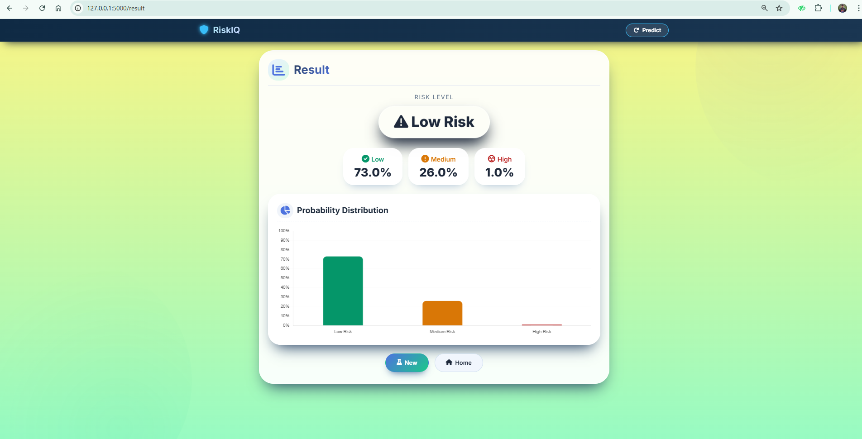
RESULTS

Slide 12
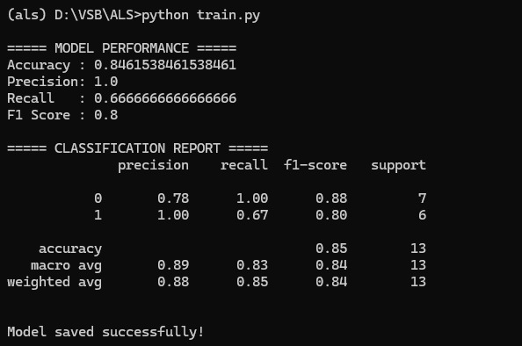
ACCURACY LEVEL

Slide 13
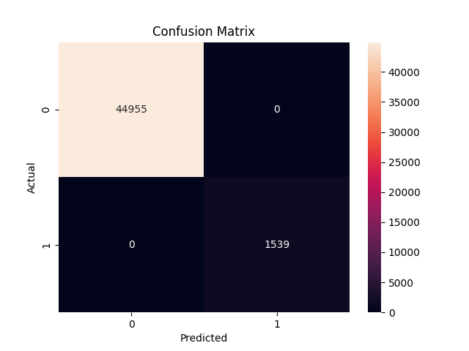
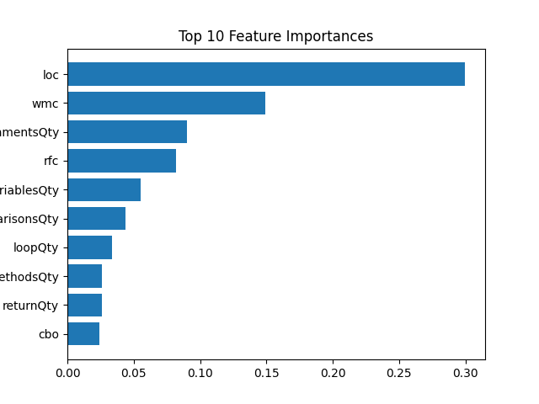
CONFUSION MATRIX / FEATURE IMPORTANCE

Slide 14
CONCLUSION
This project develops a machine learning-based system to analyze software metrics and predict risk levels. It identifies defect-prone modules and classifies them into low, medium, and high risk using the Random Forest algorithm.
The system enables early detection of risks, improving software quality and reducing maintenance effort. The web-based interface provides easy access to predictions, supporting better testing and decision making.

Slide 15
FUTURE ENHANCEMENT
Integrate advanced algorithms like XGBoost or deep learning to improve prediction accuracy. This will enhance model performance for complex datasets.
Use real-time data from sources like GitHub and CI/CD pipelines. This enables continuous monitoring and up-to-date risk prediction.
Deploy the system on cloud platforms for better scalability and accessibility. This allows users to access the system from anywhere.
Improve user interface and add advanced dashboards for better visualization. This enhances user experience and supports better decision making.

Slide 16
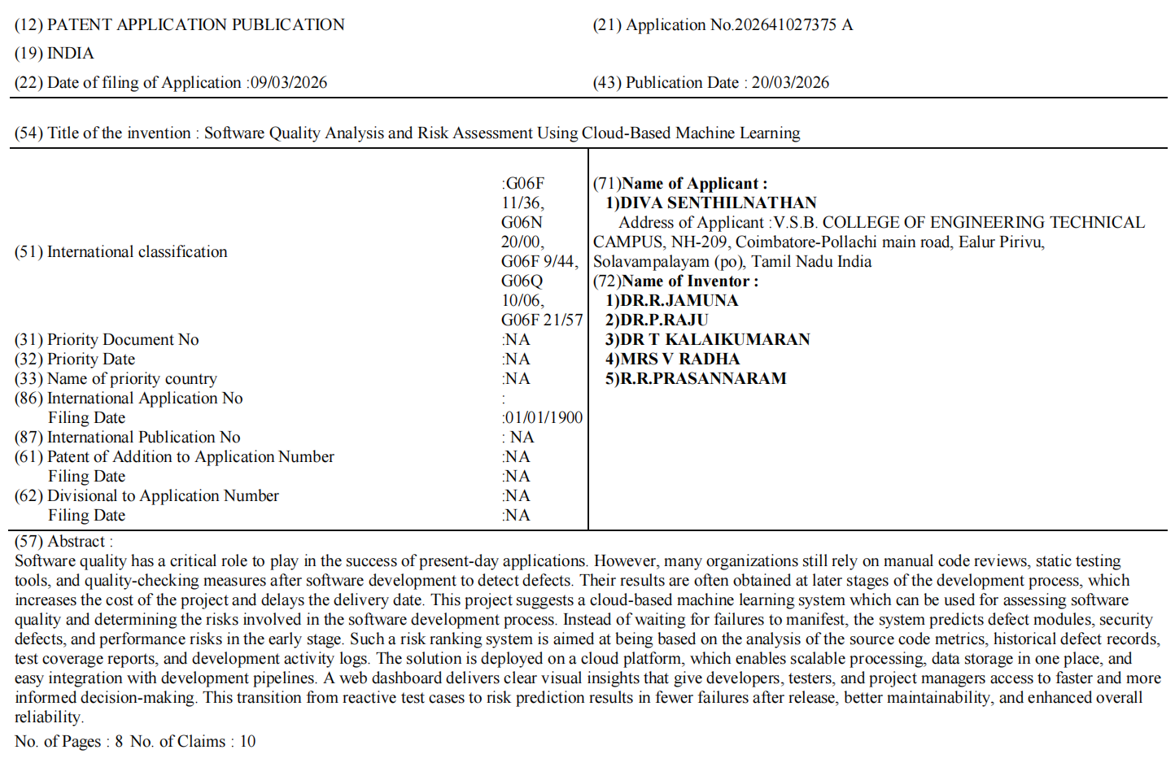
OUTCOMES

Slide 17
REFERENCES
[1] “XAI Driven Software Defect Prediction Using Adaptive Feature Engineering Coupled With Autoencoder and MLP,” IEEE Access, 2025.
[2] M. Ali, T. Mazhar, Y. Arif, S. Al-Otaibi, Y. Y. Ghadi, T. Shahzad, M. A. Khan, and H. Hamam,
“Software Defect Prediction Using an Intelligent Ensemble-Based Model,” IEEE Access, vol. 12, pp. 20376–20395, 2024.
[3] T. Menzies, A. Butcher, A. Marcus, T. Zimmermann, and D. Cok,
“Local versus global models for effort estimation and defect prediction,” IEEE Transactions on Software Engineering, 2011.
[4] G. Boetticher, T. Menzies, and T. Ostrand,
“PROMISE Repository of Software Engineering Databases,” West Virginia University, 2007.
[5] NASA Metrics Data Program (MDP),
“NASA Software Defect Datasets,” NASA, USA.

Slide 18
THANK YOU

